Slide 1


ONLINE BUS RESERVATION SYSTEM

Slide 2
GROUP DETAILES:
Neelapala.Abhilash [AP21110010527]
Nakka.Akash [AP21110010553]
Lokesh raj kumar [AP21110010555]
Challapalli.Nagasai [AP21110010558]
Kiran Venkata Sai [AP21110010565]

Slide 3
INDEX
INTRODUCTION
PROBLEM STATEMENT
OBJECTIVES
ALGORITHM
FLOW CHART
CONCLUSION

Slide 4
1.INTRODUCTION
Online booking of bus tickets is web-based application that works with a centralized network. It enables users to book tickets from any part of the world. It maintains all customer details, bus details, reservation details. Incase of offline booking of bus tickets customers need to queue up to buy bus tickets and ask for information and it may bring a lot of inconvenience to the customers. Booking bus tickets in online reduce our effort and time can also be saved.

Slide 5
2.PROBLEM STATEMENT
Booking bus tickets in online is simple and easy process which can reduce our time and our effort.
It enables us to book the seats of our choice and it also provides good customer services and many discount codes as well.
This would help the corporation and organize its schedules more efficiently on the basis of traffic demand.

Slide 6
3.OBJECTIVES
The main purpose of this online booking of bus tickets is to automate the manual procedure of booking tickets into an application.
By providing a web-based booking of bus tickets to customers, need not to queue up at the counter to purchase bus tickets.
Enabling customers to check the availability and types of busses online.

Slide 7
4.ALGORITHM
Step 1: Start
Step 2: Enter password.
Step 3: Check password. If password is
correct go to step 4,Else go to step 2.
Step 4: Displays the menu as
Add bus information
Reserve seats
Show reserved seats
Display available buses
Close application

Slide 8
4.ALGORITHM
Step 5: Get input from the user if the
input is the following choices go to
respective choice numbers
Step 5.1: Add bus information,
Step 5.1.1: Enter bus number, driver name, arrival time, departure time, from and destination.
Step 5.1.2: bus information is saved

Slide 9
4.ALGORITHM
Step 5.2: Reserve seats,
Step 5.2.1: Enter bus number, check whether the number is correct or not.
Step 5.2.2: enter seat number. And passenger name.
Step5.2.3: reserve the seat to the passenger
Step 5.3: Show the available seats in a bus,
Step 5.3.1: Enter bus number
Step 5.3.2: the name of the passenger is displayed.If it is reserved or empty is displayed.

Slide 10
4.ALGORITHM
Step 5.4: show buses available,
Step 5.41: buses information is displayed.
Step 5.5: Exit,
Step 5.5.1: closes application.
Step 6:stop

Slide 11
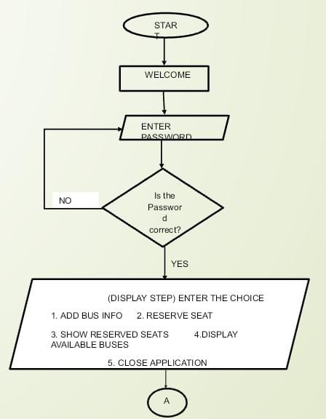
5.FLOW CHART

Slide 12
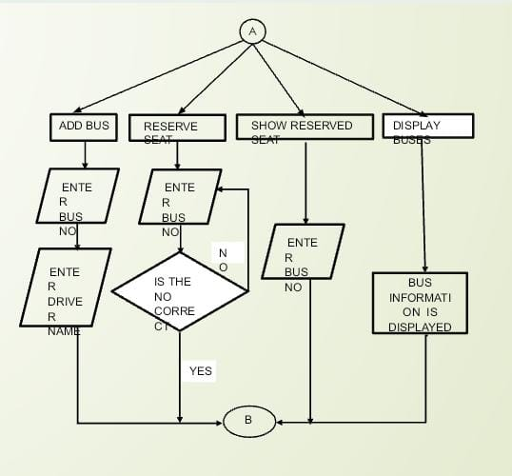
5.FLOW CHART

Slide 13
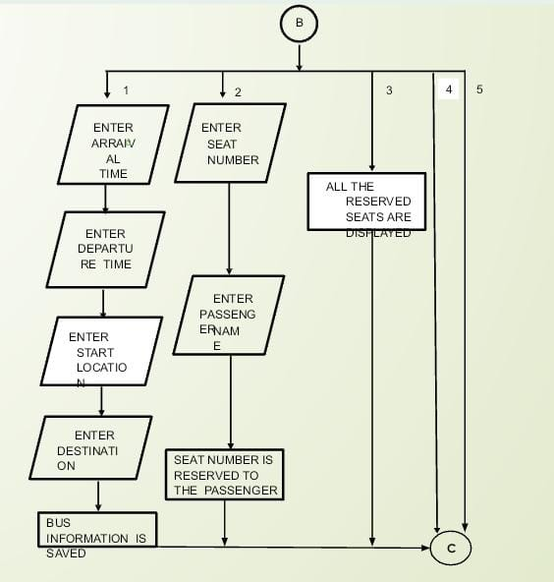
5.FLOW CHART

Slide 14
5.FLOW CHART

Slide 15
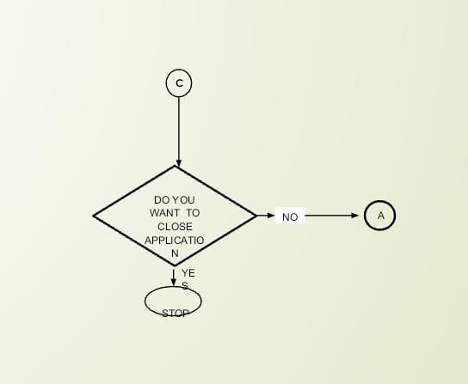
5.FLOW CHART

Slide 16
6.CONCLUSION
Finally, in Online Bus Booking System, we have developed a secure, user-friendly Bus Reservation System.
On our website any user or visitors view our system and search the bus and how many seats are available in our buses. The user can also register their own seats on the bus on this website.
By using this software, we can reserve tickets, through telephone lines, via the internet. The customer can check the availability of buses and reserve selective seats.
The project provides and reviews all sorts of constraints so that the user does give only user data and thus validation is done in an efficient manner.

Slide 17
THANK YOU

